Slide 1

Finance for IT managers
International Masters
Spring 2018 program
© Sylvie Appriou

Slide 2
Sessions calendar
Session nb | Date | Time | Contents
1 | Thursday July 12th | 10:00– 13:00 | Introduction
2 | Wednesday July 18th | 10:00 – 13:00 | Home work review + class
3 | Wednesday July 25th | 10:00 – 13:00 | Home work review + class
4 | Wednesday July 25th | 15:00 – 17:00 | Exam

Slide 3
Course schedule and contents
Session 1
Introduction
Corporate Finance general concepts
Session 2
Planning and Budgeting, Cost Management
Case study
Session 3
Project value case
Case study

Slide 4
Session contents
Finance and IT
Planning and Budget process
Portfolio based investment planning
IT costs categories
Cloud Computing
Case study

Slide 5
Finance and IT

Slide 6
Finance and IT
If you work in the IT department of a 1B$ company then…
Your IT budget is anywhere between 20 m$ and 80 m$ (between 2 and 8% of Revenue)
IT spendings represent 50 % of the company Capital Expenditures
About 20% of budget is for « new things » (projects)
The other 80% is for running and maintaining production apllications or « keeping the lights on »
The lifetime costs of an IT application are, on average, 5 times the initial project investment

Slide 7
Key IT financial processes
3 main IT financial processes
Planning and Budgeting
Linked to IT Strategic Plan
Strategic projects, Other projects, Maintenance
Portfolio management approach
Cost Management
Tracking on ongoing costs vs budget
Forecasting for any required adjustement
Chargebacks
IT costs can be kept central or be « charged back » to other departments

Slide 8
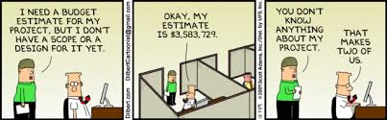
Planning and Budgeting

Slide 9
Key elements to a budget?
Situation overview:
You were recently hired as IT manager at New Corp.
Your CEO asked you to prepare a first cut of your IT budget for 2014
Q1: What do you need to know before you start?
Q2: What elements will you include into your budget?
Q1:
Last year’s budget, corporate guidelines & rules
Your CEO’s strategy, expectations, priorities and guidelines
Details on your organization, scope, goals, team, etc…
Q2:
Hardware, Software, People, Services, Expenses, etc…
Assumptions and comments

Slide 10
Why plan & budget?
Q3:
Plan and demonstrate how you will contribute in achieving your organization objectives (maximize revenue, reduce capital costs, for example)
Helps you assess & negotiate the resources needed to deliver on your role, goals, projects
Basis for cost control and monitor progress, etc…
Q4:
Demonstrate your impact
Plan investments & prioritize your requests
Increase your chances of success by increasing your level of visibility and control
Reduce risks of …
Increase your ability to deliver an IT project on time and within budget, etc…
Q3: Why is it important to budget?
Q4: What will you be able to do with a budget?

Slide 11
Planning and Budgeting process
Vision / Mission
Strategic plan
Long term goals
Operating plan
Short term goals
SMART goals
Financial plan
Budget

Slide 12
Planning is…
Planning is an intellectual process
Planning contributes to the objectives
Planning is a primary function of management
A continuous process
Planning is part of managerial activities

Slide 13
Possible definition of planning
A basic management function involving formulation of one or more detailed plans to achieve optimum balance of needs or demands with the available resources. The planning process:
Identifies the goals or objectives to be achieved
Formulates strategies to achieve them
Arranges or creates the means required
implements, directs, and monitors all steps in their proper sequence

Slide 14
Possible definition of planning
It means determining the organization's goals and defining the means for achieving them. Planning allows managers the opportunity to adjust to the environment instead of merely reacting to it. Planning increases the possibility of survival in business by actively anticipating and managing the risks that may occur in the future.
In short, planning is preparing for tomorrow, today. It's the activity that allows managers to determine what they want and how they will achieve it.
Not only does planning provide direction and a unity of purpose for organizations, it also answers six basic questions in regard to any activity:
What needs to be accomplished?
When is the deadline?
Where will this be done?
Who will be responsible for it?
How will it get done?
How much time, energy, and resources are required to accomplish this goal?

Slide 15

Typical planning processes
Strategic Planning
Planning & Budgeting
Cost Mgt & Forecasting
Chargeback
IT PLAN
1 to 3 years
BUDGET
1 year
ACTUALS

Slide 16
Role & significance of planning
Reduction of uncertainty
Better utilization of resources
Increases organizational effectiveness
Reduces the cost of performance
Concentration on objectives
Helps in co-ordination
Makes control effective
Encouragement to innovation
Increase in competitive strength
Delegation is facilitated

Slide 17
Benefits of planning
Strategic alignment
Improved decision making
Reduced risks
Increased return on investment
Optimized resource allocation and workload

Slide 18
Budget process
1. Review
The previous planning period
6. Evaluate
The effectiveness of the activity, feeding into future plans
2. Plan
The activity in a realistic and focused manner
5. Monitor
The activity
3. Secure and Allocate Resources
To achieve the planned goals
4. Implement
The planned activity

Slide 19
What is a budget?
The budget can be defined as a financial plan showing how the organization will acquire resources and use them in operations during a specified time period, usually one year
The budget takes the form of financial templates, showing expected amounts, as opposed to actual historical amounts
The budget is typically compiled by months (or quarters)
The budget is explained by detailed descriptions of what IT managers expect to do

Slide 20
Budget elements
Time horizon
The time horizon for many budgets is one year
Goals
A budget should outline the specific goals to be achieved
Data
Using good data in the formulation of a budget will lead to sound assumptions. If data is not reliable, it will be impossible to accurately predict the coming year
History
History is an important feature in a budget. A company’s past performance should be used to understand market trends, to establish historical strengths and weaknesses, and to provide a starting point for a new budget
Forecast
A budget document is a compilation of forecasts. Forecasts should represent achievable, yet motivating, goals. Additionally, forecasts should take into consideration the effects of new expectations
Variables
Variables are the factors that influence the success or failure of a forecasted goal

Slide 21
Writing your budget (1/6)
Prepare the plan
Make a list of all the things you think your organization will spend money on (a bit like a shopping list), such as salaries, rent, telephone, postage. Do not think of actual money at this stage.
You should consider:
One-off items such as, recruitment advertisements
Capital costs (fixed assets) for example, computer and office furniture will last for a few years
Running costs, which are ongoing expenses, for example, salaries, office space and telephones

Slide 22
Writing your budget (2/6)
Fill-in the figures
The more people you involve (for example, your Fin. controller, peers, internal partners and others connected with your organization) the more likely you will produce a good budget. Others can also help you to carry out research. Remember, no budget is 100% accurate.
The following questions will help you:
Was last year’s budget accurate?
Was anything forgotten?
Are there any changes in your activities?
Are there any other changes (such as an increase in rent)?
Will the cost of some things increase with inflation
Has your hierarchy agreed to give you the same amount of money as last year?

Slide 23
Writing your budget (3/6)
Make notes
It is not good enough to just guess the expenditure, or to put nice round figures for each of the headings. Once the budget has been approved, you will need to stick to it, so it is in your interest to make sure that it is as accurate and realistic as possible.
Document your assumptions. It will prove useful for budget presentations and revisions.

Slide 24
Writing your budget (4/6)
Revise the figures
Show your draft budget to to people inside your organization ( Team members, peers and management committee members):
Have you forgotten anything?
Are your assumptions and guesses fair and accurate?
Do you need more information? If so, where are you going to get it?
Do not panic as you are unlikely to get your budget right the first time round.

Slide 25
Writing your budget (5/6)
Approvals
The budget has to be approved by your management, incorporating any comments and changes that they want to make as budgets get consolidated up the management chain.

Slide 26
Writing your budget (6/6)
Monitoring & Revisions
As you move into execution, you need to track, monitor and report actuals (events, expenses, etc)
Your environment may change too
You will therefore need to regularly revise your budget

Slide 27
Budgeting methodologies
Baseline or incremental
Uses previous year budget / actual as a baseline
Does not encourage people to question previous assumptions, ways of working
Zero based
Start from scratch
More disciplined approach that encourage justification of all costs
Takes more time and effort…
In real life, budgeting is a combination of the 2 methods…

Slide 28
Two approaches to budgeting
Top-down
Bottom-up
Authoritarian
Centralized control
Simple
Top management
Shorter
Participative
Decentralized control
Complex
All levels of management
Longer
Which one is best? Why? In what situation?

Slide 29
IT budget is part of a larger “company budget”
Starts with Sales and Revenue forecast for the coming year :
Must involve people in the field plus some market analysts
Look at the big customers and their buying intentions for the coming year
Look at historical Sales trends
Analyze « adressable » market : existing customers and prospects
Combination of above is likely to provide better resul
Plan must show reasonable balance between aggressiveness and conservatism and
…Be accepted by Sales people
…Be supported by manufacturing capacity

Slide 30
IT budget is part of a larger “company budget”
Once Sales / Revenue is determine, apply company’s financial model to get the rest of the P&L
Gross profit
% of expenses
Split of expenses : R&D, Sales and Marketing, G&A including IT
Net income
Budgeting is a « Trial and error » process
Key to measure Budget vs Forecast vs Actuals and assess Forecast accuracy : it is an on going task…
Variance analysis : Why do we see a variance ? What immediate action should we take ? What are the learnings for the next budget cycle ?

Slide 31
Portfolio based investment planning

Slide 32
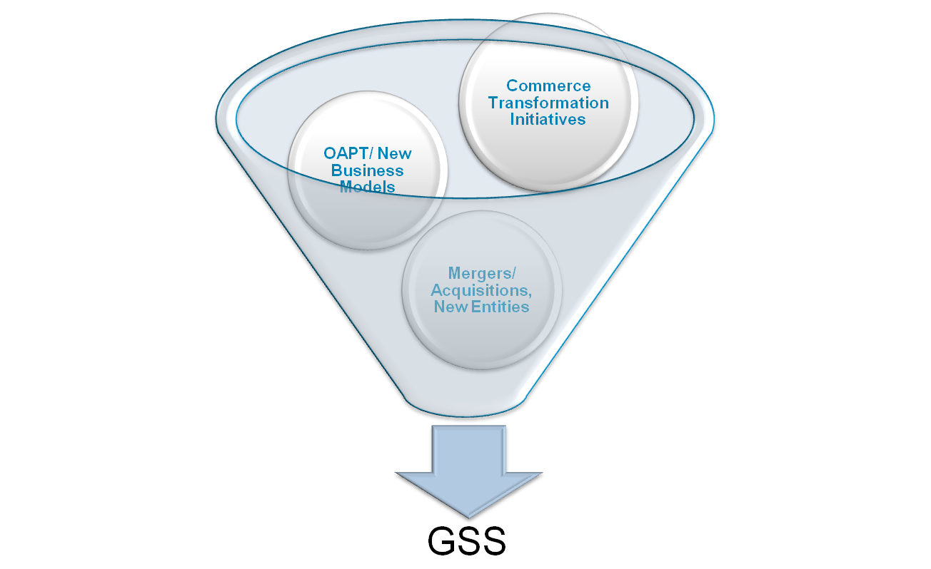
Demand Management
Demand management
IT : from Internal Service provider to Strategic differentiator
Planned vs unplanned demand (change requests, bug fixes…)
Ideas / Opportunities
Capture demand and identify opportunities
Ideas
Ideas
Project requests
Build business case
Seek executives approval
Projects
Perform detailed budgeting
and planning
Approved demand

Slide 33
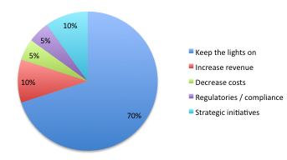
Portfolio based investment planning
Project Portfolio Management (PPM) vs Project / project
Framework for prioritization
Define categories and target % in line with company strategic priorities
Monitor actual projects vs target portfolio

Slide 34
Portfolio based investment planning
Project Portfolio Management (PPM)
Business objectives – Function – Budget (bubble size)
 | Marketing | Sales | Order management | Customer service | Finance
Increase revenue
Decrease costs
Regulatory / Compliance
Strategic initiatives

Slide 35
Categories of IT costs

Slide 36
Categories of IT costs
Travel and Entertainment
IT Overhead
People | Internal Staff Contractors Consultants
HW costs | Servers Network IT equipment
SW costs | Licences - Maintenance In house development
Services | Telecoms Outsourcing Cloud computing

Slide 37
Categories of IT costs
Capex : Capital expenditures
Depreciated over the life of the asset
Depreciation is an expense line on the P&L (no cash impact)
Opex : Operational expenses to run day to day business
Accounting rules
Preliminary project phase / feasibility study : Opex as no asset may result from it…
HW equipment is Capex
SW development and application configuration : Capex as this creates an asset
Post implementation / production phase : Opex as it is running day to day business
Note that SW licence maintenance is Opex vs licence is Capex

Slide 38
Categories of IT costs
Accounting rules
Functional design is Opex and technical design is Capex
Production upgrades and enhancements are capitalizable while small changes and maintenance are not…
Development costs of one time data migration interfaces are not capitalizable because no asset result from it
T&E are Opex except if part of a capitalizable activity !
…There is room for interpretation : need to follow rules of the company

Slide 39
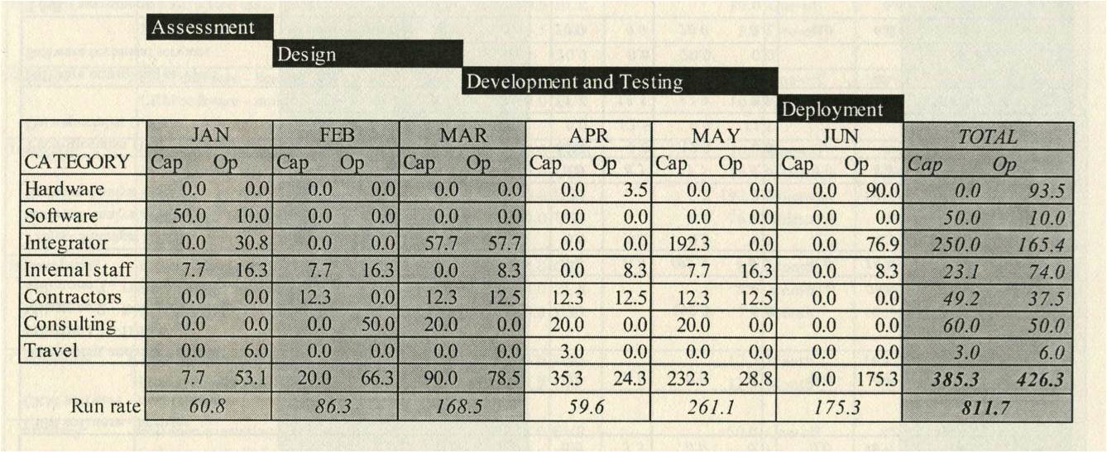
Example of project budget

Slide 40
Example of project budget
Items in local currency need to be converted in reporting currency
Laptop purchases are Opex in this example. Depending on the value (5k$...), country and company rules, can be capex or Opex
CRM SW licence are Capex but associated yearly maintenance costs are Opex
CRM integrators milestones are Opex or Capex depending on the project phase
T&E are Opex or Capex depending on the project phase
Infrastructure costs can or not be part of the project budget : some companies manage their infrastructure budget separately
Budgeting drives capacity planning

Slide 41
Cloud Computing ITaaS

Slide 42
Cloud computing or ITaaS (IT as a Service)
Monthly rental fee for external services hosted in a data center
Per user for an application (SW as a Service, SaaS)
By capacity for a server (Infrastructure as a Service IaaS)
By usage for a SW development environment (Platform as a Service or PaaS)
No capital costs (no HW purchased, no assset created…), only Opex
Impact on budgeting…
Usually, CIO prefer Capex as it has a lower impact on Opex..Pushes today’s costs to future costs
Could argue that the longer you keep a system, the more expensive rental becomes (depreciation has an end)

Slide 43
Cloud computing or ITaaS (IT as a Service)
Why is Cloud computing so successful then ?
Predictable
Scale your user base up and down
Flexibility to pull out at no cost
Should be more cost effective (vendors could realize better economies of scale than IT departments)

Slide 44
Planning and budgeting Key takeaways
IT plan / budget must be linked with company strategic objectives
Portfolio approach for project prioritization
Capex vs Opex
Budget accuracy to be closely monitored
IT budget can be centralized or de-centralized (or combination)

Slide 45
Budget model

Slide 46
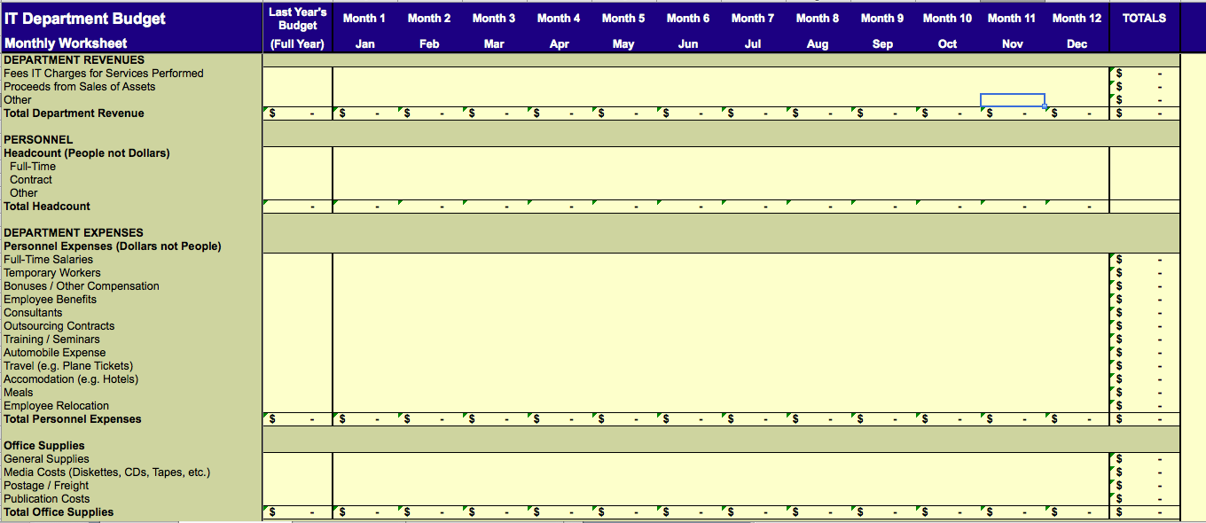
Budget model

Slide 47
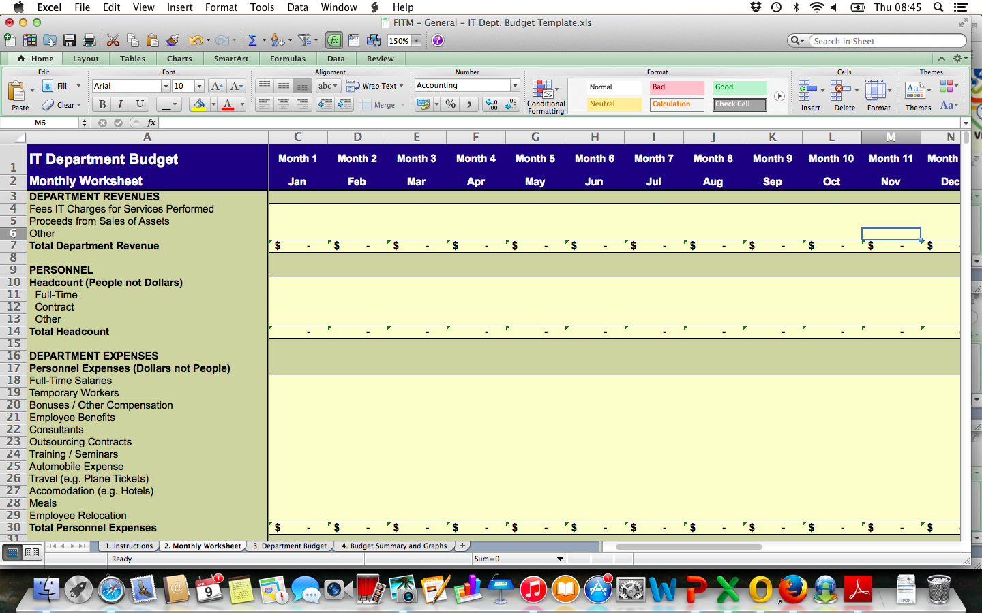
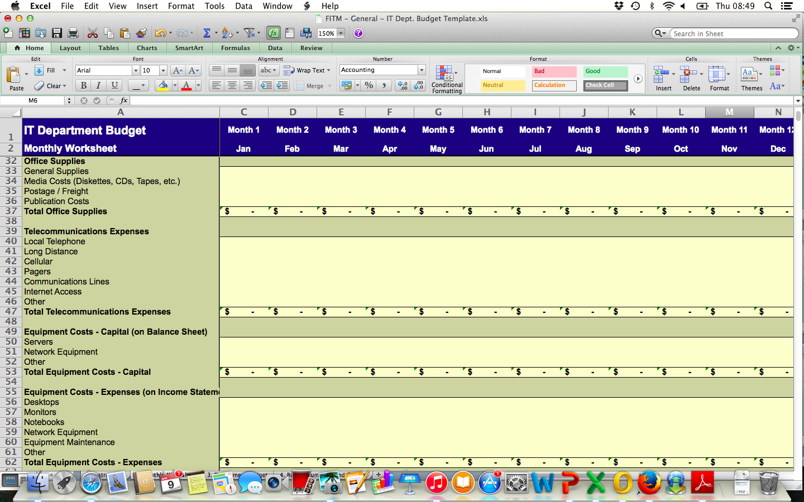
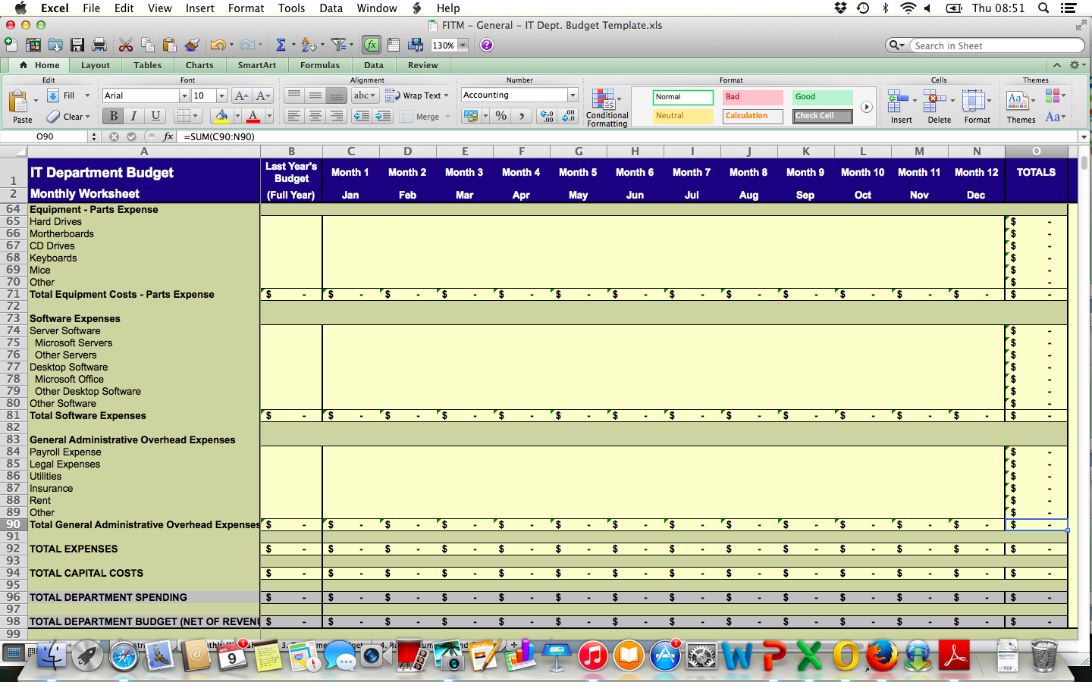
Budget model

Slide 48
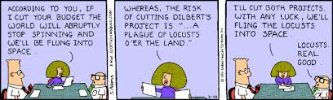

Slide 49
Thank you!
See you next time

